Slide 1
Constrained Discretion Approach for FXI Triggers
January 2023
Romain Veyrune and Zhuohui Chen (MCMCO)

Slide 2
Table of Contents
Challenges
Conceptual Framework
Intervention Decision : Historical versus Predictive-Conditional Norm
Conditional Volatility Modelling
Model Selection and Combination

Slide 3
Challenge : differentiating “normal” market conditions from “disorderly” market conditions
2012 Decision on Bilateral and Multilateral Surveillance (IMF 2012): “a member should intervene in the exchange market if necessary to counter disorderly conditions, which may be characterized inter alia by disruptive short-term movements in the exchange rate of its currency”
Multiple indicators could be considered including (i) short-term exchange rate vol; (ii) bid ask spread; (iii) market turnover; (iv) other liquidity metrics (see Lybek and Sar 2002); (v) order book; and (vi) qualitative information.
Indicators could be presented to the policy market in a “dashboard” or “heat map.”
The “heat map” should include critical value i.e. define norms for the indicators.
The rest of the presentation would focus on:
Indicator = short-term volatility; and
data-driven methods to determine the “norm.”

Slide 4
Conceptual framework : discretion under constraint
The constraint: the central bank will not intervene within the “normal” daily change in the exchange—the “nonintervention region.”
The discretion: once the daily change excess the norm—in the “intervention region”—the central bank can but does not have to intervene, depending on whether it deems the exceedance justified.
What consideration for deciding of intervention in the “intervention” region?
Financial frictions
Financial stability
Dis-anchoring of inflation expectation
And other consideration discussed in the Integrated Policy Framework workstream (https://www.imf.org/en/Topics/IPF-Integrated-Policy-Framework)

Slide 5
Conceptual framework : Intervention Decision
13h00 exchange rate
Published 13h15
Non-intervention region : no intervention
Intervention region
Management decision : 13h30
Announce the auction 13h35
Allot the auction 13h50
No intervention
Mid-day observed exchange rate to ensure that enough transactions took place for a representative rate.

Slide 6
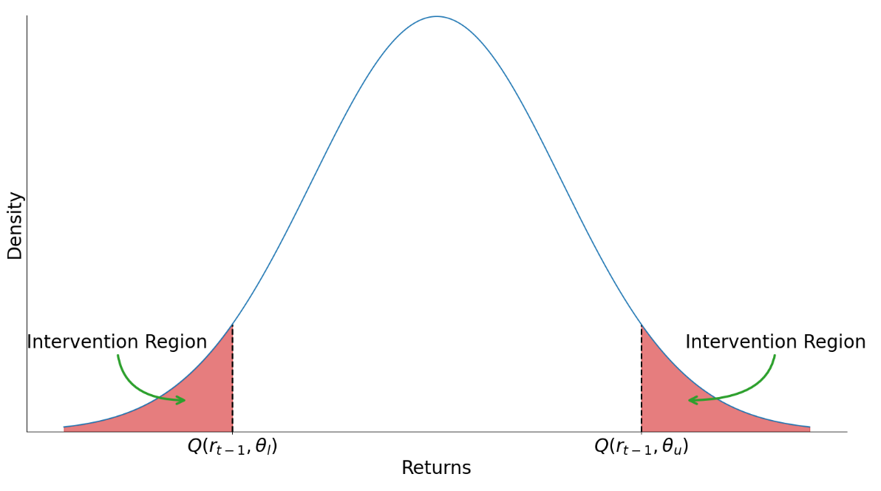

Intervention Decision—Option 1: Historic Volatility Norm
$Q\left(r_{t−1}\right)$ is the historical distribution of the exchange rate log returns
The triggers are defined by percentile $θ$ of the historical distribution
Prepared by IMF staff

Slide 7
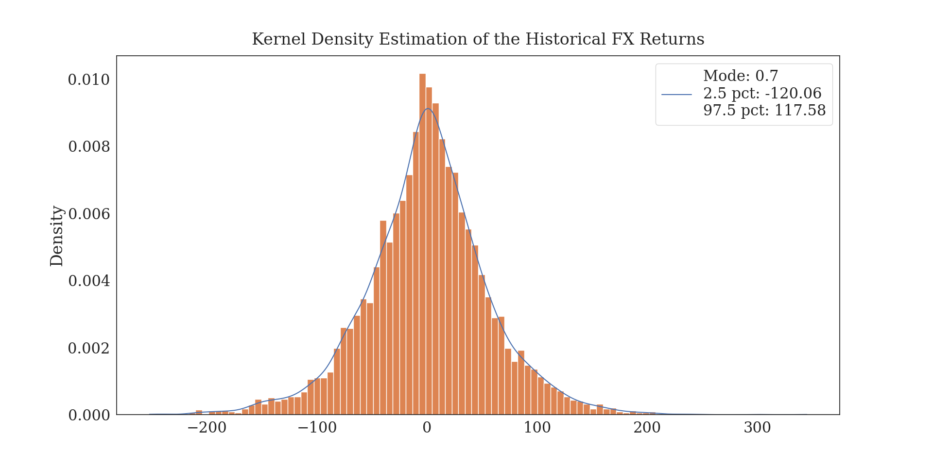
Intervention Decision—Option 1: Historic Volatility Norm
Source: Bloomberg data and IMF staff calculation

Slide 8
Intervention Decision—Option 1: Historic Volatility Norm Advantages and Shortcomings
Advantages
Simple, intuitive and transparent, easily replicable.
Shortcomings
Backward-looking, heavily influenced by past data, and only slowly adapting to new volatility regime.
Does no accurately predict future FXI – could lead to excessive or insufficient FXI.

Slide 9
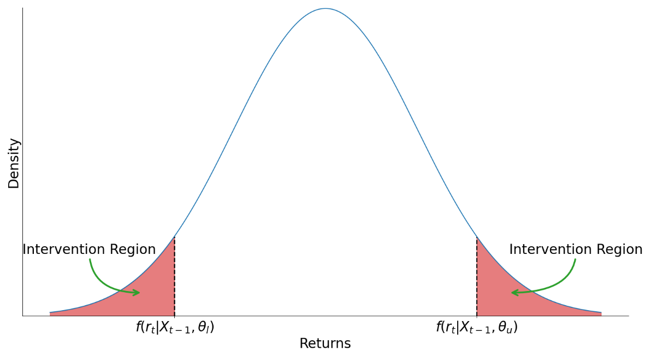
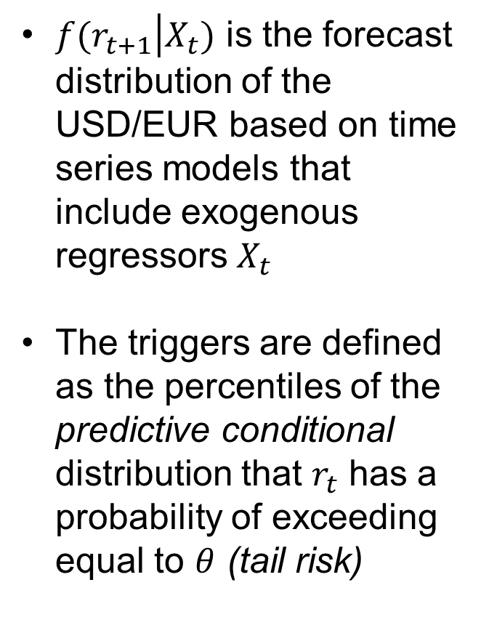
Intervention Decision—Option 2: Model-based Volatility Norm
$f(r_{t+1}\left|X_{t}\right.)$ is the forecast distribution of the USD/EUR based on time series models that include exogenous regressors $X_{t}$
The triggers are defined as the percentiles of the predictive conditional distribution that $r_{t}$ has a probability of exceeding equal to $θ$ (tail risk)
Prepared by IMF staff

Slide 10
Intervention Decision—Option 2: Exogenous Variables
International context : VIX, Interbank rate spread EUR USD overnight, Oil price
Domestic factors : Spot bid/ask spread, USD/EUR forward overnight, USD/EUR forward 1w, Implied USD/EUR overnight volatility, Implied USD/EUR 1w volatility
Other possible exogenous regressors:
Net Open Position limits
Spot/forward dealt volume
Past intervention dummy and volume
Seasonality dummy

Slide 11
Intervention Decision—Option 2: advantages and shortcomings
Advantages
Forward looking, respond to expected market development, rapidly adjust to new market conditions.
Robust, accurately predict the frequency of FXI, budget neutral if symmetric, financially sound.
Capture FX non-linearities and asymmetries between appreciation and depreciation.
Factor in change in some fundamentals factors via the exogenous regressors.
Shortcomings
More complicated, less easily replicable (could be an advantage if speculation is a concern).

Slide 12

Conditional Volatility Modelling
$$r_{t}= μ+{\sum_{i=1}^{p}{φ_{i}r_{t−i}}+γ^{′}x_{t}^{′}+ε}_{t} (1)$$
$σ_{t}^{2}=…$ (2)
$$ε_{t}= σ_{t}e_{t}, { e}_{t} \sim Some Distribution (3)$$
List of exogenous variables
EWMA, RiskMetric2006, ARCH, GARCH, eGARCH, gjrGARCH
Normal, Student T,
Skewed T, Generalized Error
is a mean model, an Autoregressive (AR) process with exogenous regressor
is a volatility process
a distribution for the standardized residuals

Slide 13
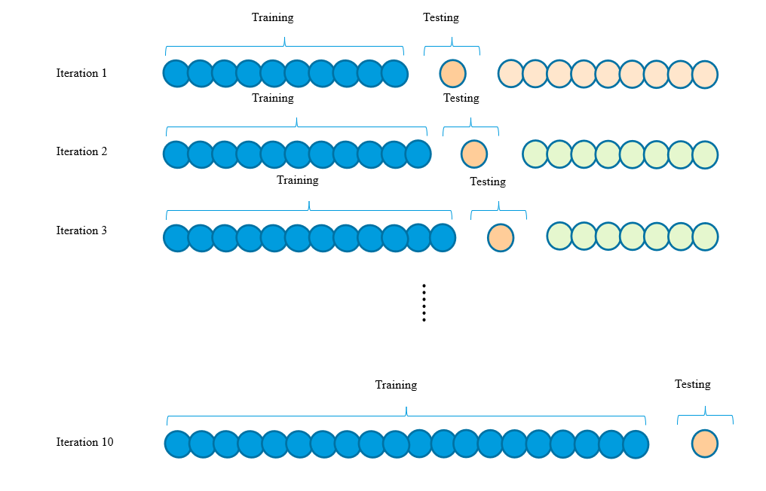
Model Selection: Evaluating predictive performance and overcoming overfitting
In sample vs Out of sample: Out of sample testing is preferred, which uses “new” data which is not found in the dataset used to build the model. “Predictive performance”
Cross validation to overcome overfitting. Overfitting is a modeling error in statistics that occurs when a function is too closely aligned to a limited set of data points
Performance metric for point forecast –
conditional mean: Root mean square errors
Performance metric for probabilistic forecast – conditional density: Mean Interval Score
Prepared by IMF staff

Slide 14
Model Selection: Top 5 Models for Mean and Density
 |  | Lag 1 FX logret | EURUSD 1w fw fd | EURUSD ovn fw fd | Implied EURUSD vol ovn fd | Interbank ovn spread | Bid ask abs | Num of obs | CV RMSE (Mean) | CV MIS (Density)
Conditional mean | Model 34 [ARCH, SkewStudent] | -0.03* | -0.86 |  | -0.33 |  |  | 4752 | 48.975 | 241.35
 | Model 91 [ARCH, SkewStudent] | -0.03* | -1.04 |  | -0.24 | 1.09 |  | 4521 | 48.976 | 241.18
 | Model 91 [EGARCH, SkewStudent] | -0.02 | -0.95 |  | -0.09 | 0.54 |  | 4521 | 48.977 | 246.62
 | Model 9 [ARCH, SkewStudent] | -0.03* |  |  | -0.33 |  |  | 4754 | 48.977 | 241.37
 | Model 36 [ARCH, SkewStudent] | -0.03* |  |  | -0.25 | 1.1 |  | 4523 | 48.978 | 241.30
Conditional density | Model 29 [RiskMetric, Normal] | -0.03* |  | -0.12 |  | 0.65 |  | 5055 | 49.094 | 217.44
 | Model 7 [RiskMetric, Normal] | -0.02 |  |  |  | 0.67 |  | 5198 | 49.111 | 217.45
 | Model 5 [RiskMetric, Normal] | -0.02 |  | 0.06 |  |  |  | 5317 | 49.083 | 217.57
 | Model 1 [RiskMetric, Normal] | -0.02 |  |  |  |  |  | 5658 | 49.100 | 217.59
 | Model 20 [RiskMetric, Normal] | -0.02 |  |  |  | 0.68 | 279.22 | 5198 | 49.118 | 217.76
Source: Bloomberg data and IMF staff calculation

Slide 15

Model Combination: Pooling Threshold and Weight
With model combination, a more reliable recommendation can be obtained, overcoming any limitations of individual models
Removing models from the pool in an ad-hoc manner is not advisable. Models are included in the pool as long as the increase in error is gradual
A threshold can be set to detect whether an inclusion of a model will introduce dramatic jump in the error
$$Threshold_{i}=Q{\left(0.75\right)}_{i}+1.5IQR_{i}$$
where the index $i$ corresponds to the model number (models are ranked from best to worst), $Q(0.75)$ is the 3rd quartile, and IQR is the interquartile ranger, i.e., $Q(0.75)$ – $Q(0.25)$
A metric-based weight can be designed for combining the models in the pool
$$w_{i}=\frac{x_{i}^{−1}}{\sum_{i=1}^{k}{x_{i}^{−1}}}$$

Slide 16
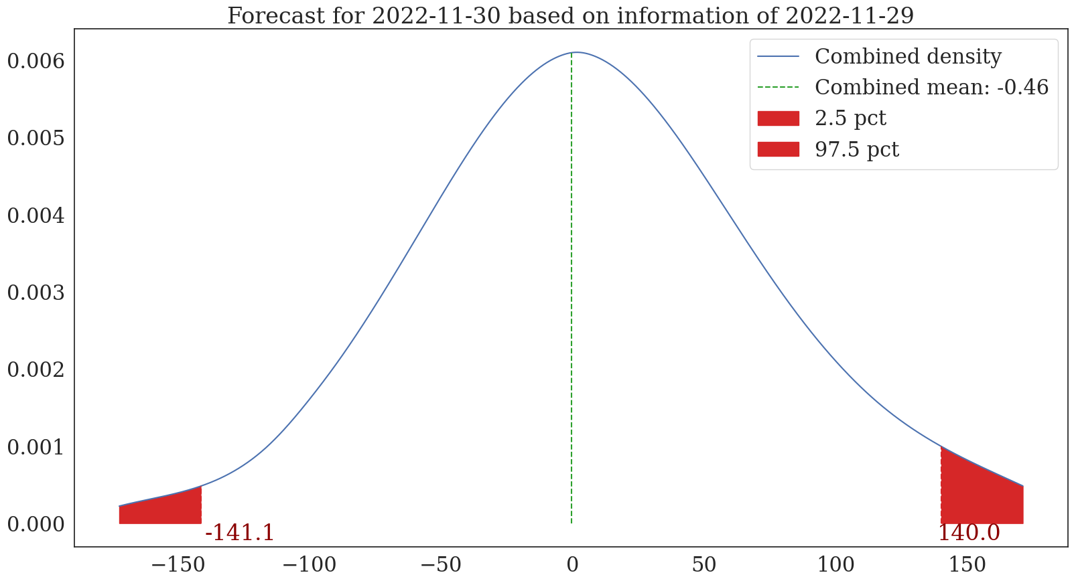
Decision—Option 2: Conditional Distribution as of November 30 (model combination)
Source: Bloomberg data and IMF staff calculation

Slide 17
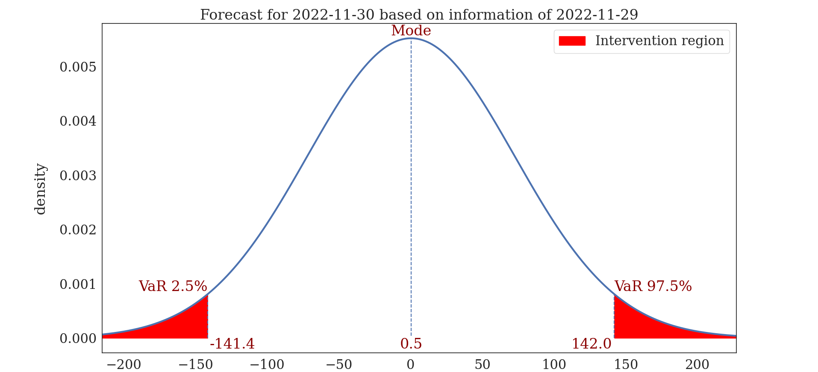
Decision—Option 2: Conditional Distribution as of November 30 (best density model)
Source: Bloomberg data and IMF staff calculation

Slide 18
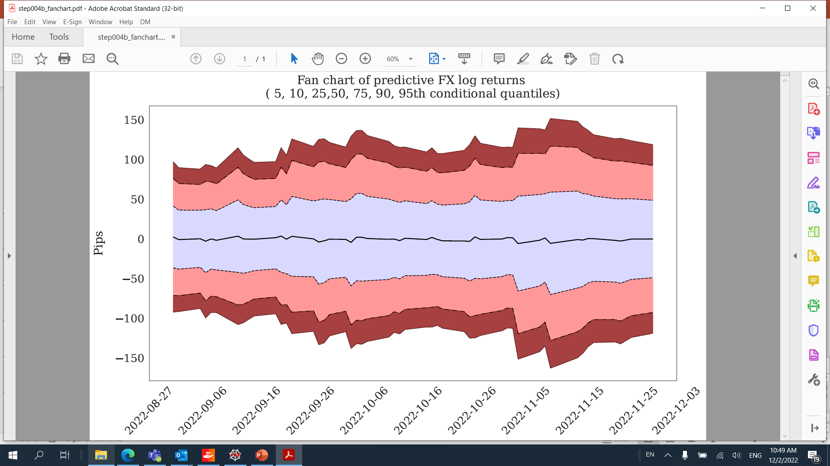
Decision—Option 2: Conditional Distribution Dynamics from September
Source: Bloomberg data and IMF staff calculation

